Slide 1

DALIPARTHI SAI SANDEEP
Final Project

Slide 2




KEYLOGGER AND SECURITY
It may come as no surprise that keyloggers have been used for spying on people since the beginning of computers. According to Wikipedia, keyloggers were used for many different purposes in the 1970s and early 1980s, including secret government operations.
One of the most famous early events happened in the middle of the 1970s when Soviet spies made a very smart hardware keylogger that they used to spy on IBM Select typewriters in the US Embassy and Consulate buildings in Moscow and St. Petersburg. Once they were in place, the keyloggers measured the slight changes in each typewriter’s magnetic field that could barely be seen as the print head turned and moved to type each letter. In the meantime, Soviet embassies choose to type classified information on manual typewriters instead of electric ones.

Slide 3


The importance of understanding keyloggers and enhancing security measures against them cannot be overstated, as these tools pose a significant threat to personal and organizational data security. Keyloggers, whether implemented through software or hardware, can covertly capture sensitive information such as passwords, financial details, and private communications, leading to severe consequences like identity theft, financial loss, and corporate espionage. Effective security practices, including the use of robust antivirus software, regular system monitoring, and adherence to safe browsing habits, are crucial in detecting and preventing keylogger infections.

Slide 4


AGENDA
Introduction of keyloggers and security
Understanding the problem statement
Overview of the project
The end users in project
Solution and value proposition
The “wow” factor in the solution
Detecting the keyloggers
Prevention strategies
Modelling
Results

Slide 5

PROBLEM STATEMENT
Keyloggers are type of malware that can steal sensitive information from device such as passwords , card numbers, messages. If this data falls into the wrong hands, it can lead to serious consequences, including identity theft, financial loss, and fraud. The increasing prevalence of keyloggers poses a significant threat to digital security, compromising the confidentiality and integrity of sensitive information.
Keyloggers pose a threat to the security of an organization’s sensitive data and systems. When sensitive data such as passwords is typed into a computer, there are no protections in place preventing it from being collected by malware. A keylogger can steal sensitive data that can be used for various purposes effects the personal details of the individuals, financial loss, identity thefts
They are challenging to create. They require knowledge of how keyboards function. They are quite difficult to detect and remove, especially by user-space applications. They have an opportunity to get access to all keyboard data as it travels to the OS. Activity logs may be accessed remotely over the Internet, from a safe distance.

Slide 6

PROJECT OVERVIEW
This project aims to address the critical need for effective detection and prevention methods against keyloggers. It will explore the current landscape of keylogger technology, evaluate existing security measures, and develop innovative solutions to enhance protection against these threats. By doing so, the project seeks to mitigate the risks associated with keyloggers, safeguard personal and organizational data, and promote a secure digital environment.
Securing your internet is of paramount importance in today’s digital world. In an age where personal information and financial data are often stored online, the need to understand different cybersecurity threats and how to protect against them cannot be overstated. One particular threat is a keylogger, a malicious program designed to track and record every keystroke on a computer or mobile device, thereby gaining unauthorized access to personal data. This guide aims to provide you with an in-depth understanding of what a keylogger is how they work and the various ways you can protect yourself from this insidious
keylogger, short for keystroke logger, is a type of cyber threat that records the keys struck on a keyboard, typically covertly, so the person using the keyboard is unaware that their actions are being monitored. This enables attackers to gain unauthorized access to confidential information, such as passwords, credit card numbers, and other sensitive data, which can then be used for identity theft, financial fraud, and other forms of cybercrime.

Slide 7

WHO ARE THE END USERS?
Keyloggers, also known as keystroke loggers or system monitors, can have many end users, including individuals, businesses, and government . Even Parents can use keyloggers to monitor their children's online activities, such as screen time, WhatsApp interactions, call logs, and location. The major end users are:
Employers: can use keyloggers to monitor employee productivity and behavior, especially in remote work environments. This can help ensure employees adhere to company policies, such as cybersecurity and data leak prevention.
Information technology departments :can use keyloggers to troubleshoot issues on a device.
Security professionals and ethical hackers :can use keyloggers to identify vulnerabilities in computer systems and networks.
Cybercriminals: can use keyloggers to steal sensitive information, such as passwords, credit card numbers, and personal data. This information can be used for identity theft, financial fraud, or other criminal activities.
Federal bodies :have used keyloggers during investigations, such as the FBI's use of a keylogger in 1999 to gather evidence against Nicodemo Scarfo Jr., a reputed Cosa Nostra mobster.

Slide 8
Advantages of Keyloggers:
Monitoring and Surveillance: Keyloggers can be used for legitimate monitoring purposes, such as parental control to ensure children's online safety or employee monitoring to track productivity and adherence to company policies.
Data Recovery: In situations where data is accidentally lost, keyloggers can sometimes help recover the lost information by capturing keystrokes before they are deleted.
Investigative Tool: Law enforcement agencies and legal professionals can use keyloggers as part of their investigative toolkit to gather evidence in criminal cases or track suspicious activities.
System Diagnostics: Keyloggers can assist IT professionals in diagnosing technical issues and troubleshooting problems by providing a detailed log of user interactions.

Slide 9
Disadvantages of keylogger:
Privacy Invasion: Keyloggers have the potential to infringe on individuals' privacy by capturing sensitive information, such as passwords, personal messages, and browsing history, without their consent or knowledge.
Misuse and Abuse: Keyloggers can be misused for malicious purposes, such as stealing passwords, financial information, or intellectual property, leading to identity theft, financial fraud, or corporate espionage.
Legal and Ethical Concerns: The use of keyloggers without proper authorization or consent may violate privacy laws and ethical principles, resulting in legal repercussions and damage to reputation if discovered.
Security Vulnerabilities: Keyloggers themselves can become targets for exploitation by cybercriminals, leading to security vulnerabilities and potential breaches if not properly secured or maintained.
Cost and Complexity: Implementing comprehensive security measures can be costly and complex, requiring investment in software, hardware, personnel training, and ongoing maintenance.

Slide 10

YOUR SOLUTION AND ITS VALUE PROPOSITION
Anti-Key-logger – As the name suggest these are the software which are anti / against key loggers and main task is to detect key-logger from a computer system.
Anti-Virus – Many anti-virus software also detect key loggers and delete them from the computer system. These are software anti-software so these can not get rid from the hardware key-loggers.
Automatic form filler – This technique can be used by the user to not fill forms on regular bases instead use automatic form filler which will give a shield against key-loggers as keys will not be pressed .
One-Time-Passwords – Using OTP’s as password may be safe as every time we login we have to use a new password.
Patterns or mouse-recognition – On android devices used pattern as a password of applications and on PC use mouse recognition, mouse program uses mouse gestures instead of stylus.
Voice to Text Converter – This software helps to prevent Keylogging which targets a specific part of our keyboard.

Slide 11

THE WOW IN YOUR SOLUTION
Revolutionary AI-Powered Detection: Our solution utilizes cutting-edge artificial intelligence (AI) algorithms to detect and prevent keylogger threats with unprecedented accuracy and efficiency. By continuously analyzing user behavior patterns and keystroke dynamics, our AI-driven system can identify even the most sophisticated keyloggers in real-time, providing proactive protection against evolving threats.
Predictive Behavioral Analysis and Auto-Remediation: Our solution harnesses the power of predictive behavioral analysis to anticipate and preemptively neutralize keylogger threats. By analyzing user behavior patterns and device interactions in real-time, our system can accurately predict when a keylogger is attempting to compromise the system.
11

Slide 12
MODELLING
Import Required Modules:
Use Python's keyboard module to capture keystrokes.
Optionally, use other modules for logging, encryption, or network communication.
Set Up Logging:
Configure logging settings to specify the format and destination of log files.
Define Keylogger Function:
Create a function to capture and log keystrokes.
Use the keyboard.on_press() method to register a callback function to capture each key press event.
Main Function:
Create a main function to start the keylogger and keep it running indefinitely.
Testing and Deployment:
Test the keylogger program to ensure it captures keystrokes correctly.
Deploy the keylogger on target systems if necessary, ensuring compliance with legal and ethical considerations.
12

Slide 13
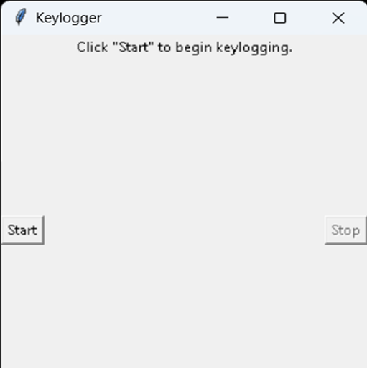
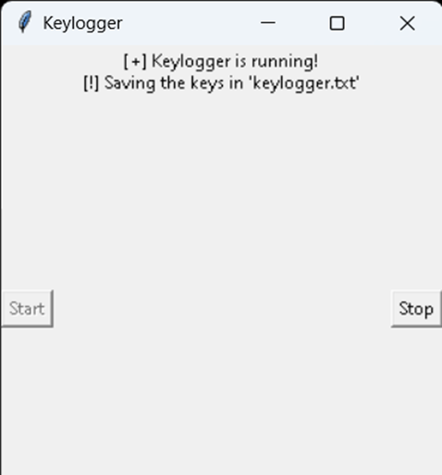
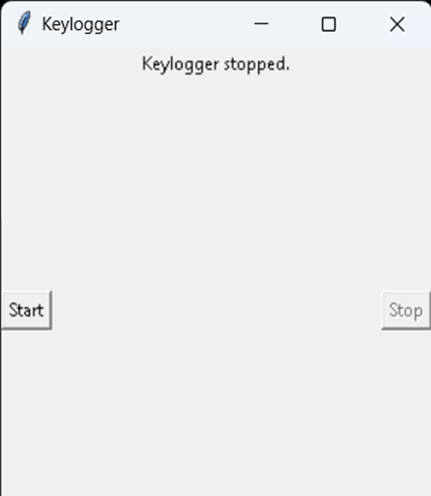
RESULTS
The result of a keylogger program typically involves capturing and logging keystrokes entered by a user on a keyboard. These logged keystrokes can then be used for various purposes, depending on the intent of the keylogger user. The covert nature of keyloggers allows them to capture sensitive information, including passwords, personal messages, and financial details, without the user's knowledge or consent. This poses serious risks to individuals, organizations, and society at large, including identity theft, financial fraud, and unauthorized access to confidential data.
13

Slide 14
https://github.com/saisandeep3314/saisandeepdaliparthi.git

